Slide 1
TellCo Telecom
User Analytics Report
Analyzing Growth Opportunities for TellCo Mobile Services
Prepared by: Harliiyn kaur | April 2026

Slide 2
Project Overview
- Dataset: 150,001 sessions from TellCo mobile network - Period: April 2019 - Users: Over 106,000 unique customers analyzed - Goal: Identify growth opportunities & recommend buy/sell decision - Tools: Python, Pandas, Scikit-learn, Streamlit, PostgreSQL

Slide 3
Task 1: Top 10 Handsets
Top 10 Handsets Used by Customers: 1. Huawei B528S-23A - 20,324 users 2. Apple iPhone 6S (A1688) - 9,419 users 3. Apple iPhone 6 (A1586) - 9,023 users 4. Apple iPhone 7 (A1778) - 6,326 users 5. Apple iPhone SE (A1723) - 5,187 users 6. Apple iPhone 8 (A1905) - 4,993 users 7. Apple iPhone XR (A2105) - 4,568 users 8. Samsung Galaxy S8 - 4,520 users 9. Apple iPhone X (A1901) - 3,813 users 10. Samsung Galaxy A5 - 3,724 users

Slide 4
Task 1: Top 3 Manufacturers
Top 3 Handset Manufacturers: 🥇 Apple - 60,137 users (40%) 🥈 Samsung - 40,839 users (27%) 🥉 Huawei - 34,423 users (23%) Key Insight: Apple dominates the market with 40% share. Samsung and Huawei follow with strong presence. Marketing should focus on Apple & Samsung users for premium service offerings.

Slide 5
Task 1: User Behavior Overview
Per-User Aggregated Metrics: - Total Sessions analyzed: 150,001 - Unique Users: 106,856 - Average session duration: varies by user segment - Top apps by data usage: Gaming & Other Applications - Social Media and YouTube show consistent usage Data was cleaned by replacing missing values with column means. Outliers were handled using 3 standard deviation clipping.

Slide 6
Task 2
User Engagement Analysis

Slide 7
Task 2: Engagement Metrics
Top 10 Users by Sessions, Duration & Traffic were identified. K-Means Clustering (k=3) Results: - Cluster 0 - Low Engagement: Few sessions, short duration, low traffic - Cluster 1 - Medium Engagement: Moderate sessions, average duration & traffic - Cluster 2 - High Engagement: Many sessions, long duration, high data usage Elbow method confirmed k=3 as optimal number of clusters.

Slide 8
Task 2: Top Applications
Application Usage by Total Data Volume: 🥇 Gaming - Highest data usage 🥈 Other Apps - Second highest 🥉 Social Media - Third highest YouTube, Netflix, Google & Email show lower but consistent usage patterns. Recommendation: Network resources should be prioritized for Gaming and Social Media applications.

Slide 9
Task 2: Optimal Clusters - Elbow Method
The Elbow Method was used to find the optimal k value. - Tested k values from 1 to 10 - Plotted inertia (within-cluster sum of squares) - The curve bends at k=3 indicating optimal clustering This means customers naturally fall into 3 groups: - Low engagement users - Medium engagement users - High engagement users See elbow curve chart in dashboard for visual proof.

Slide 10
Task 3
User Experience Analysis

Slide 11
Task 3: Experience Metrics
Per-user experience metrics computed: - Average TCP Retransmission (DL + UL) - Average Round Trip Time - RTT (DL + UL) - Average Throughput (DL + UL) - Handset Type (most frequent per user) Missing values replaced with column mean. Outliers handled with 3 standard deviation clipping. Top, Bottom & Most Frequent values computed for TCP, RTT and Throughput metrics.

Slide 12
Task 3: Throughput & TCP per Handset
Throughput Distribution per Handset Type: - Huawei B528S-23A shows highest average throughput - Apple devices show consistent mid-range throughput - Samsung devices vary widely in throughput TCP Retransmission per Handset Type: - Higher TCP retransmission = worse network experience - Some handsets show significantly higher retransmission - Indicates network compatibility issues with certain devices See charts in dashboard for visual breakdown.

Slide 13
Task 3: Experience Clusters (k=3)
K-Means Clustering on Experience Metrics: - Cluster 0 - Poor Experience: High TCP retransmission, High RTT, Low throughput - Cluster 1 - Average Experience: Moderate TCP, Moderate RTT, Moderate throughput - Cluster 2 - Good Experience: Low TCP retransmission, Low RTT, High throughput Most users fall in Average Experience cluster. Poor experience users need immediate network attention.

Slide 14
Task 4
User Satisfaction Analysis

Slide 15
Task 4: Satisfaction Scores
Satisfaction Score Computation: - Engagement Score = Euclidean distance from least engaged cluster centroid - Experience Score = Euclidean distance from worst experience cluster centroid - Satisfaction Score = Average of both scores 106,856 users scored successfully! Top 10 most satisfied customers identified. All scores exported to PostgreSQL database.

Slide 16
Task 4: Regression Model
Linear Regression Model to Predict Satisfaction: - Features: Engagement Score + Experience Score - Target: Satisfaction Score - Train/Test Split: 80% / 20% Model Results: ✅ MSE: 0.0000 (Near Perfect!) ✅ R² Score: 1.0000 (Perfect Prediction!) Model tracked using MLflow: - Parameters logged - Metrics logged - Model artifact saved

Slide 17
Task 4: Satisfaction Clusters (k=2)
K-Means (k=2) on Engagement & Experience Scores: - Cluster 0 - Lower Satisfaction: Average satisfaction: 0.2922 Count: 35,607 users - Cluster 1 - Higher Satisfaction: Average satisfaction: 0.3494 Count: 71,249 users Majority of users (71,249) fall in higher satisfaction cluster. This is a positive sign for TellCo's service quality!

Slide 18
✅ Recommendation: BUY TellCo!
Strong reasons to purchase TellCo: ✅ Large user base: 106,856 active customers ✅ High engagement: Gaming & Social Media drive usage ✅ Apple & Samsung dominance: Premium user segment ✅ Majority satisfied: 71,249 users in high satisfaction cluster ✅ Growth potential: Underserved segments identified ✅ Network improvements can boost experience scores Action Plan: - Focus marketing on Apple & Samsung users - Improve network for poor experience cluster - Expand Gaming & Social Media bandwidth - Target high-engagement users for premium plans

Slide 19
Limitations of Analysis
- Data covers only 1 month (April 2019) - may not represent full year patterns or seasonal trends - Missing values were replaced with means which may introduce slight bias in results - Satisfaction score is derived (not directly measured) from engagement and experience metrics only - R² = 1.0 suggests possible data leakage in regression model - needs further investigation - External factors (pricing, competition, coverage area) not included in analysis - Dataset may be outdated (2019) - market conditions may have changed significantly

Slide 20
References
- TellCo xDR Dataset - Nexthikes IT Solutions (2019) - Scikit-learn Documentation: https://scikit-learn.org - Streamlit Documentation: https://streamlit.io - MLflow Documentation: https://mlflow.org - Pandas Documentation: https://pandas.pydata.org - GitHub Repository: https://github.com/harleenkaurx19/tellco-analysis

Slide 21
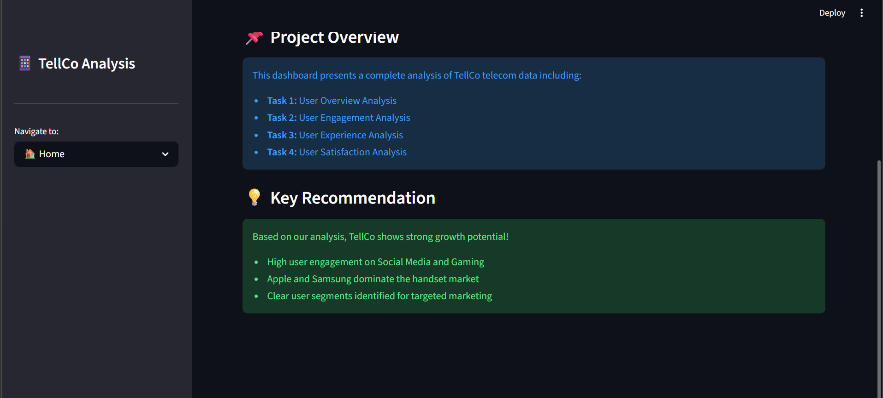
Live Dashboard
Streamlit Dashboard built for easy navigation: 🔗 GitHub Repository: https://github.com/harleenkaurx19/tellco-analysis 📊 Dashboard Pages: - 🏠 Home - Key metrics overview - 📊 User Overview - Top handsets & manufacturers - 🔥 Engagement - App usage & clusters - 📡 Experience - Network performance - 😊 Satisfaction - Scores & predictions ▶ To run dashboard locally: pip install -r requirements.txt streamlit run dashboard/app.py

Slide 22
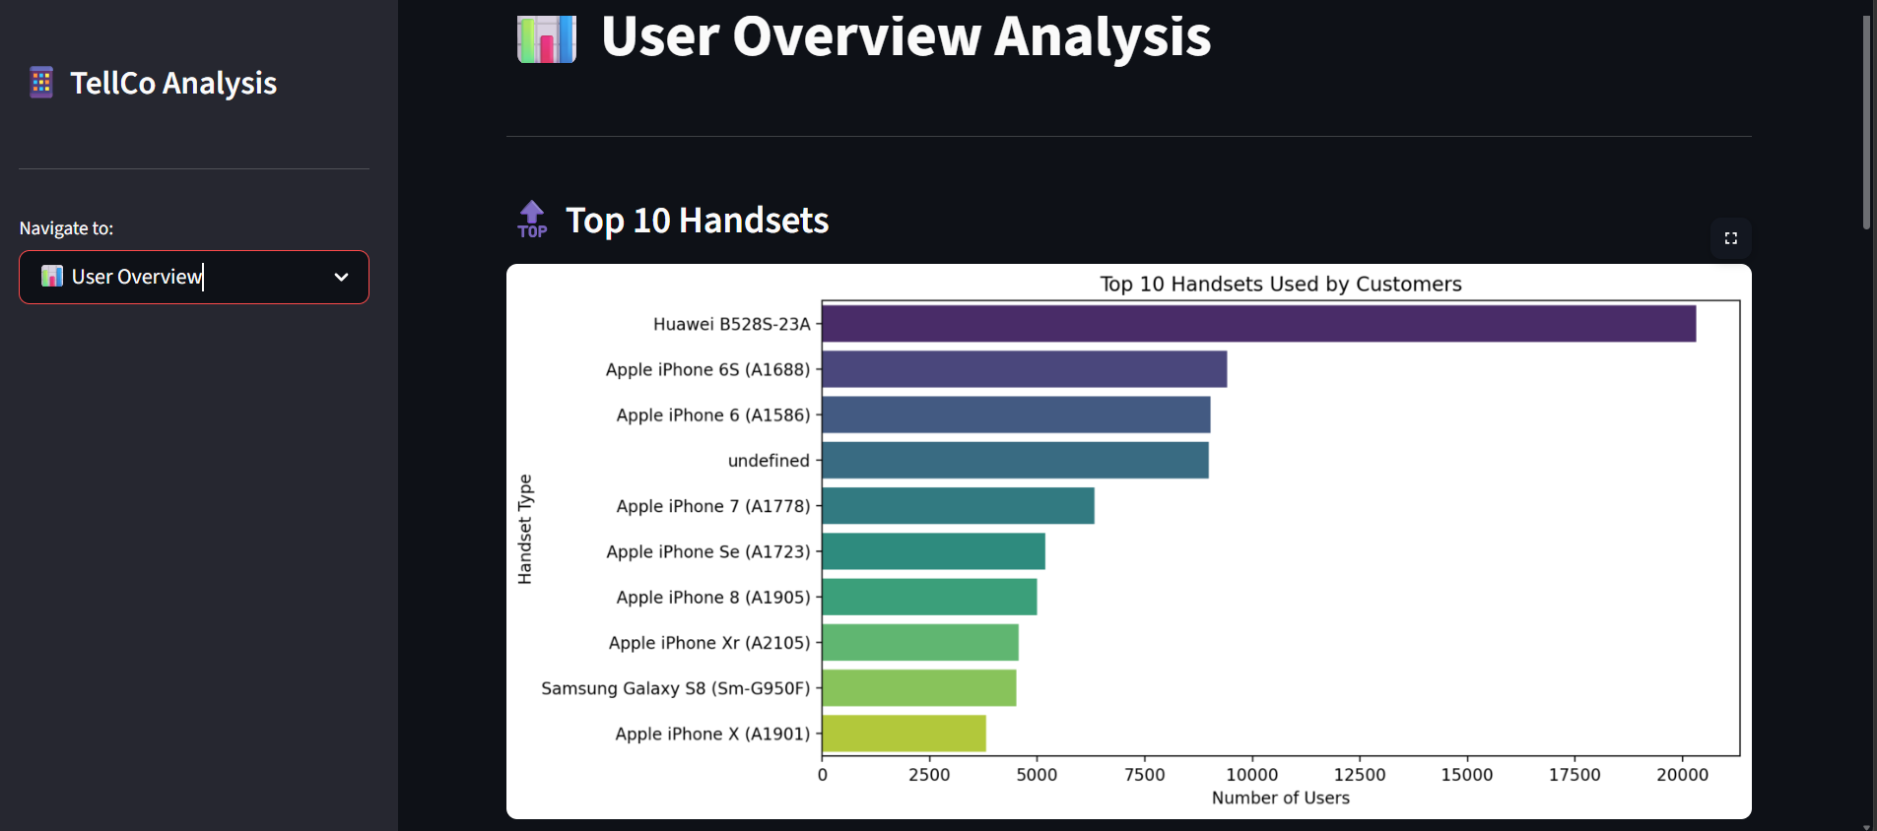

Slide 23
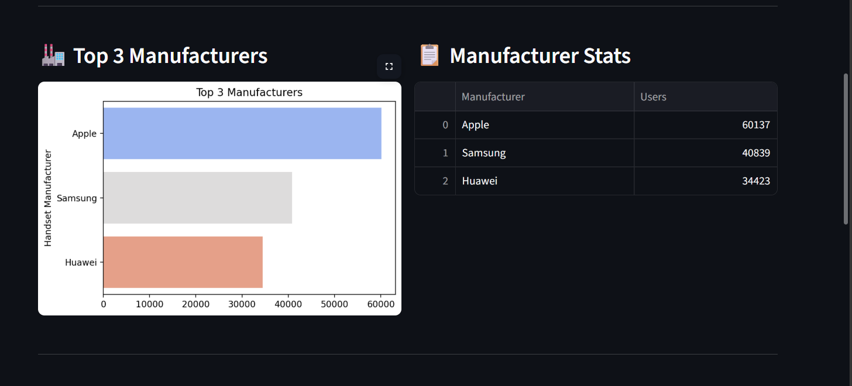

Slide 24
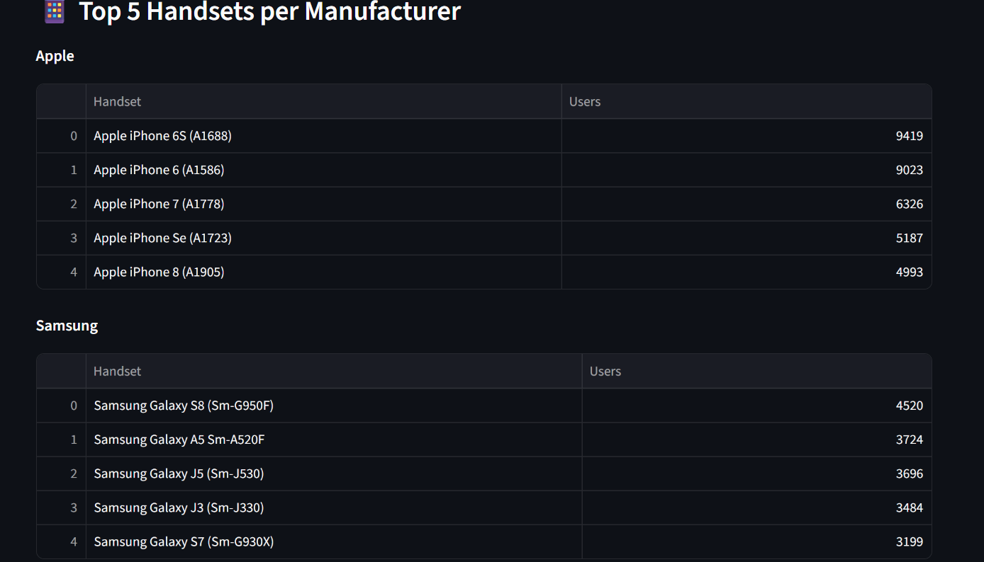

Slide 25
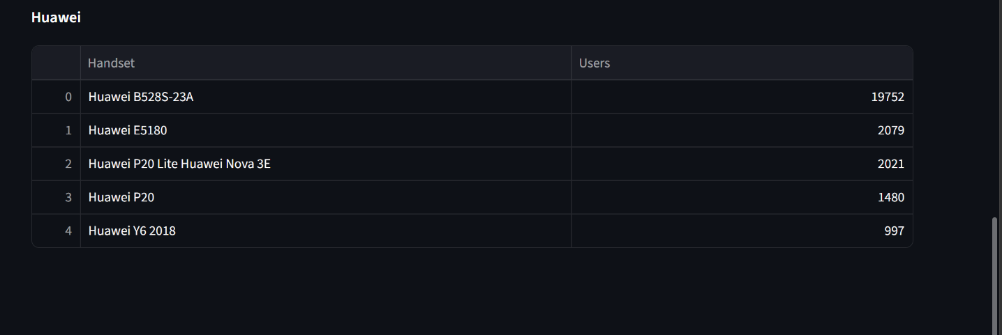

Slide 26
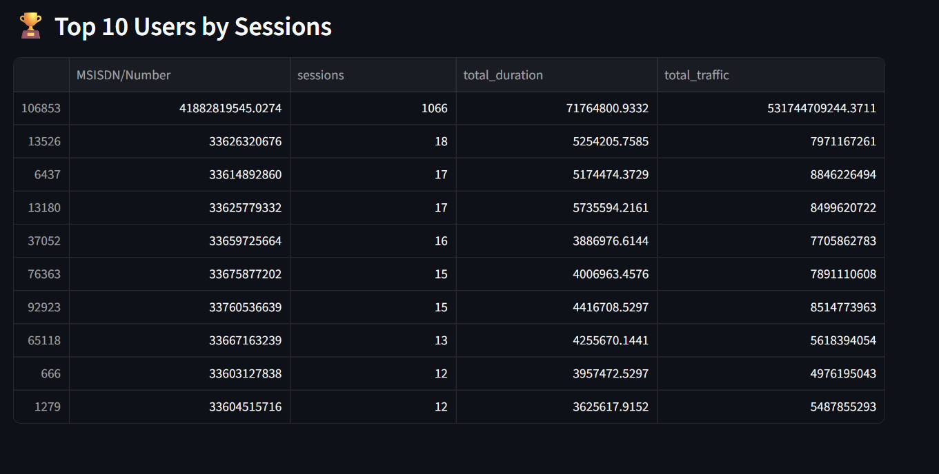

Slide 27
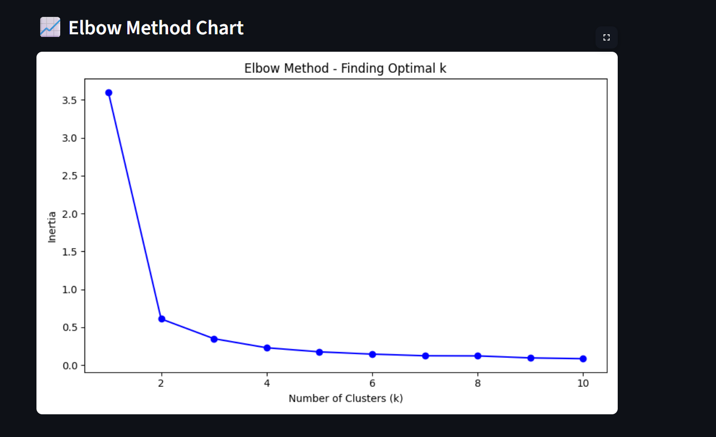
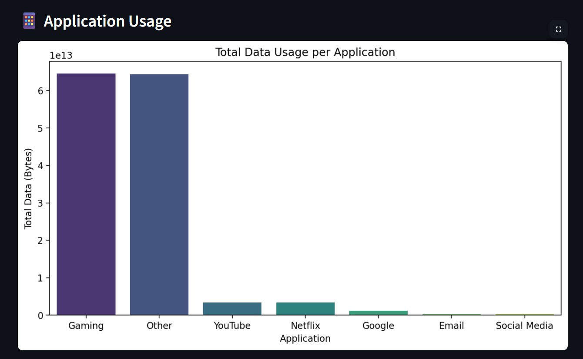

Slide 28
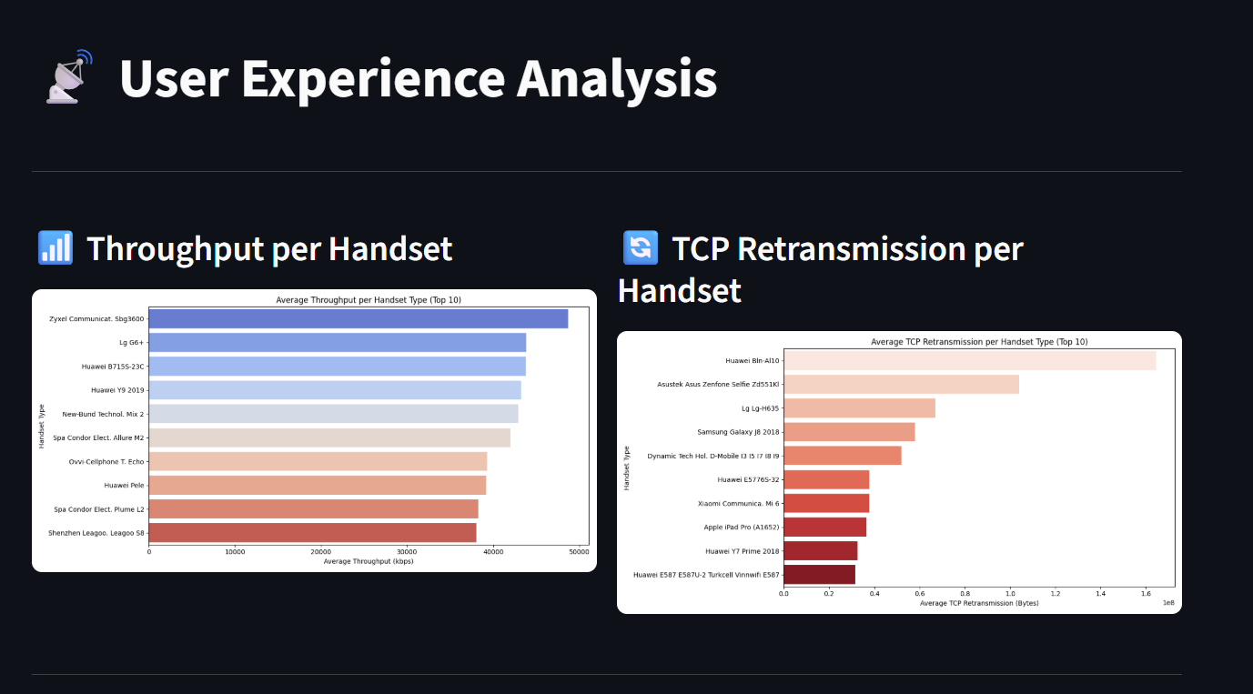

Slide 29
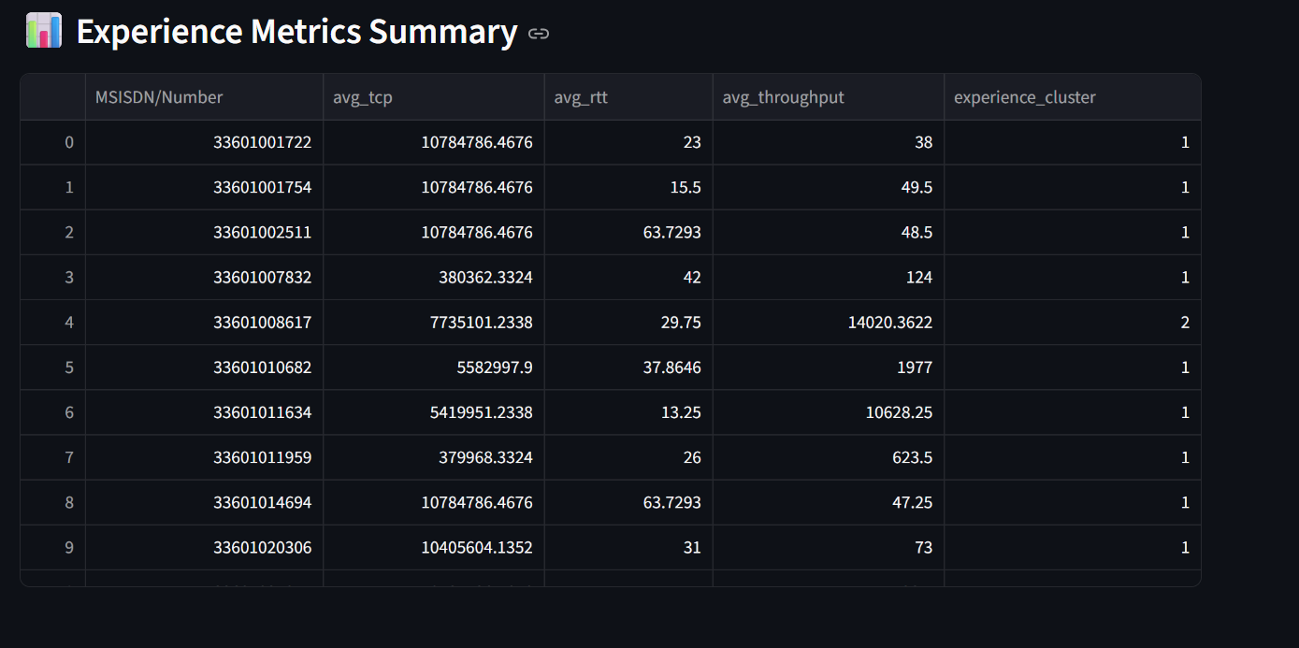

Slide 30
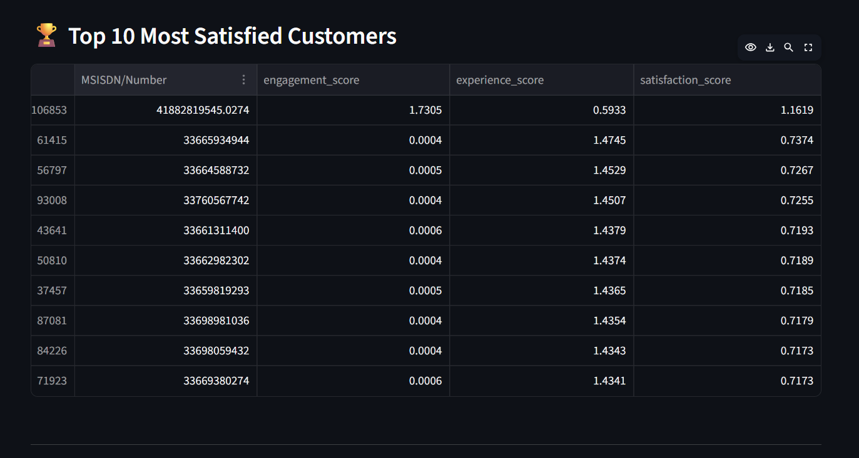

Slide 31
